Slide 1

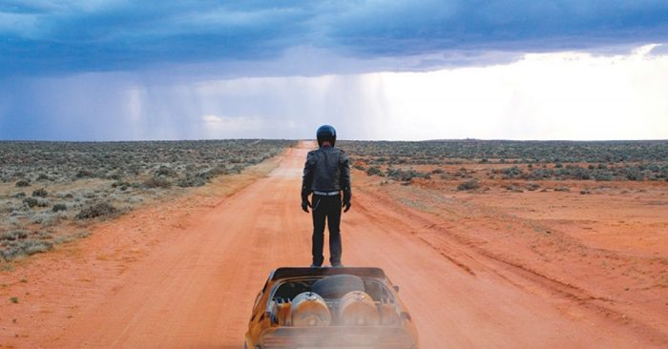
EXPERIMENT 4: TIME BASED
Mentor Artist: Vernon Ah Kee
Lens Focus: Psychological Over Time
This experiment investigates how identity, emotion and experience can be communicated through time-based media. You will explore how meaning develops through duration, movement and sequence.
FIA1 OVERARCHING INQUIRY QUESTION: How can reinterpreting people, places and objects through an artistic lens communicate my viewpoint about connection?
EXPERIMENT 4: SUB-QUESTION: How does the use of time and movement change the psychological meaning of a subject (object, place or person)?

Slide 2
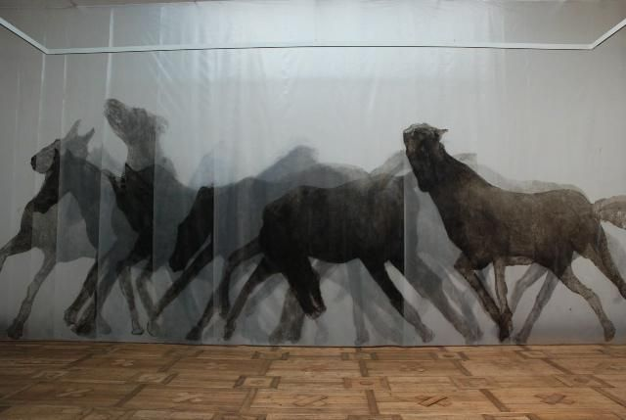
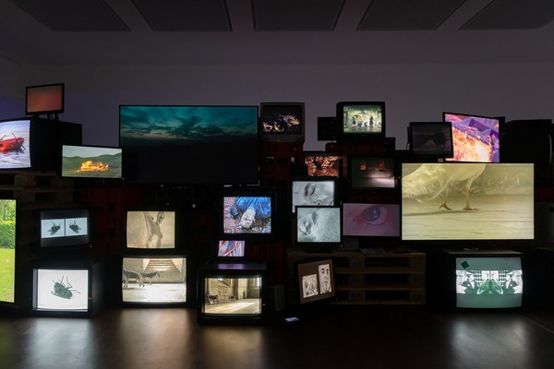
Focus Lens:
Psychological Over Time
PRACTICAL ACTIVITY
Task: Time-Based Exploration
Create a time-based artwork (video or stop motion) that explores psychological or emotional change over time.
You must choose ONE focus: • Object • Place • People
Objective: To explore how time and movement can communicate meaning, identity and connection.
Instructions: Develop a time-based work that shows change across time. This could include:
• emotional shifts • identity development • transformation of a place or object • the impact of a memory or event
Your chosen subject must remain central to the work and show clear transformation over time.
Your work should communicate how meaning evolves, not just what is seen.
MEDIA OPTIONS
• video • stop motion • photographic sequence • digital editing
Choose a format that best communicates meaning, not simply what feels easiest.
Personal Context: How does your chosen subject (object, place or person) connect to your identity, memories or experiences over time?
Contemporary Context: How do contemporary artists use time-based media to explore identity, change and lived experience?

Slide 3
How does your subject (object, place or person) change psychologically, emotionally or conceptually over time?
What is different at the end compared to the beginning?
In art, this lens explores how meaning develops through time rather than being fixed in a single image. Instead of capturing one moment, artists use duration, sequence and change to reveal deeper emotional or conceptual ideas.
Time-Based Work: Meaning develops across multiple moments
Static Image: Meaning is captured in a single moment
Time becomes the medium.
Artists use this lens to show: • emotional shifts (e.g. calm → tension → release) • changes in identity or perception • transformation of a subject (object, place or person) • the impact of memory, repetition or experience
Meaning is not immediate, it unfolds.
Key Idea: What changes over time is what creates meaning.
This could be: • movement of the body • change in environment or light • repetition of an action • editing, pacing or sequencing

Slide 4


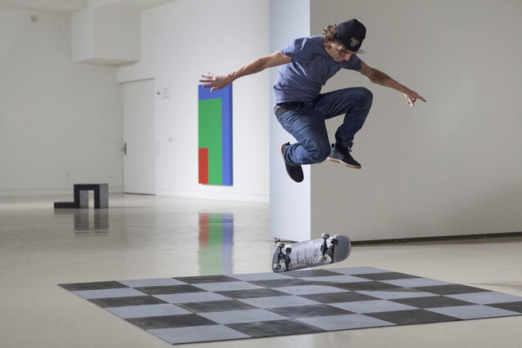
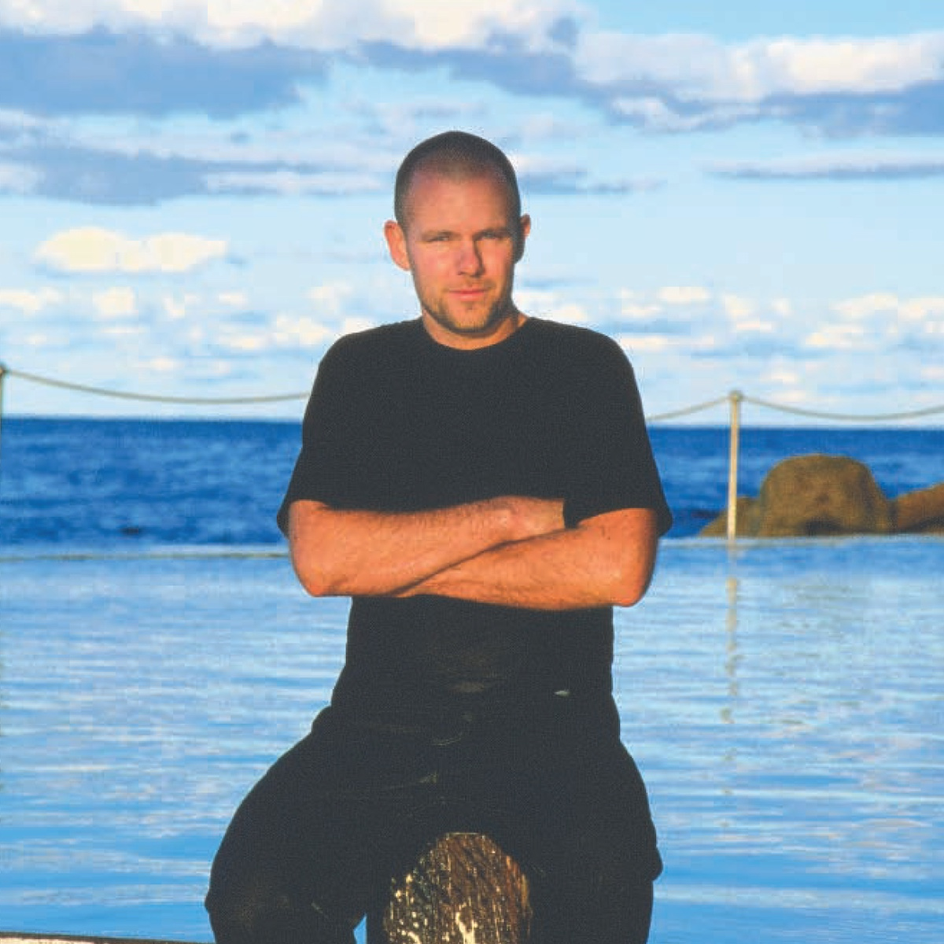
Shaun Gladwell is an Australian artist who works across video, performance and photography. His practice explores movement, time and the relationship between the body and environment.
His work often focuses on:
repetition and duration
slow motion and extended time
the body moving through space
the experience of place
Key Themes in Gladwell’s Work:
movement and repetition
the passage of time
the body in relation to place
physical and psychological experience
His works are not just recordings, they are carefully constructed to shape how time is experienced by the viewer.

Slide 5
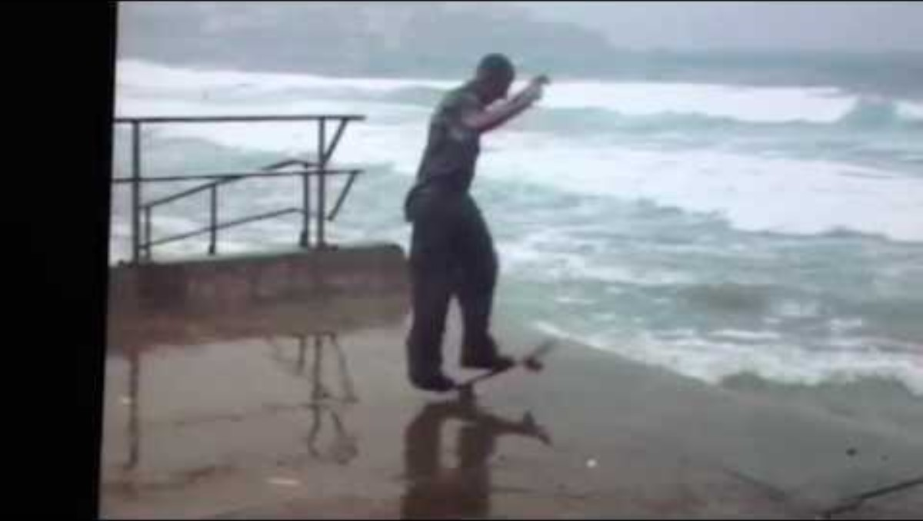
Storm Sequence — Psychological Lens
In Storm Sequence, Gladwell uses slow motion video to show a figure performing repetitive movement in an urban landscape. The extended duration transforms a simple action into a reflective, almost meditative experience, where time slows and meaning develops through repetition.
Visual Language
Gladwell creates meaning through: • slow motion • repetition of action • extended duration • framing of the body within space
These decisions shift the work from documenting action to exploring experience over time.
Personal Context: Gladwell’s work reflects an interest in movement, physical experience and the relationship between the individual and their environment.
Symbolic Significance: The body becomes a way of exploring experience, presence and the passage of time.
Contemporary Context: His work engages with contemporary culture, including urban environments, youth culture and the use of video as an artistic medium.

Slide 6

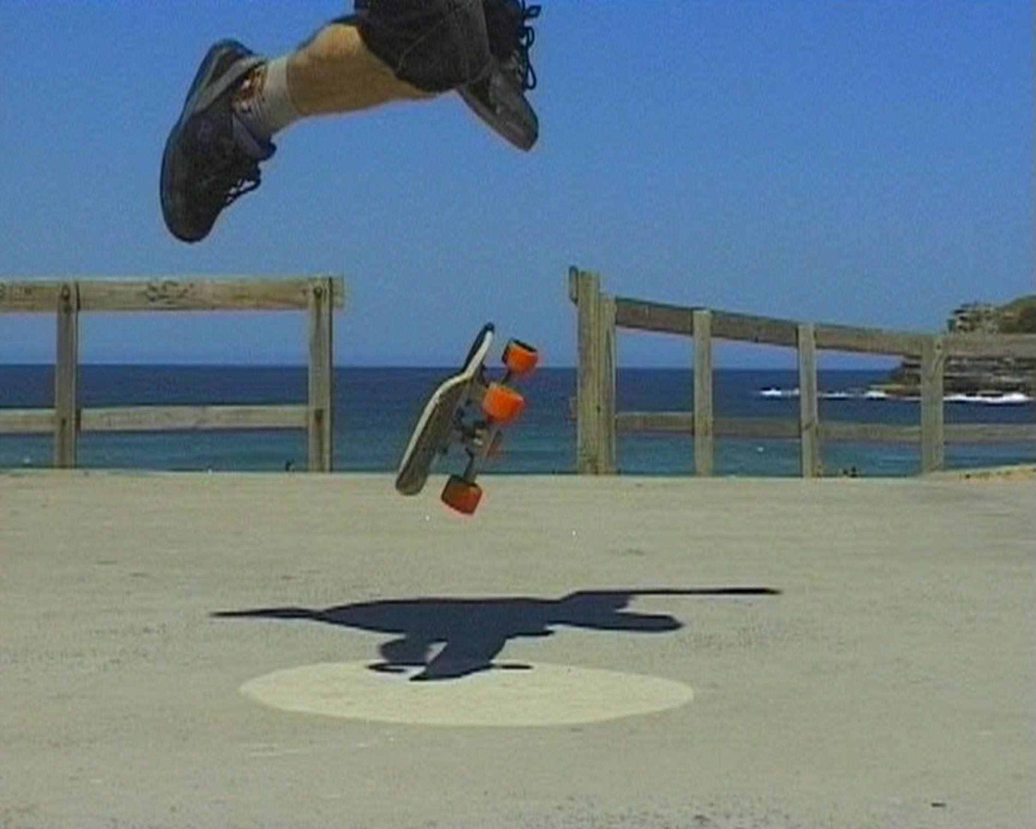
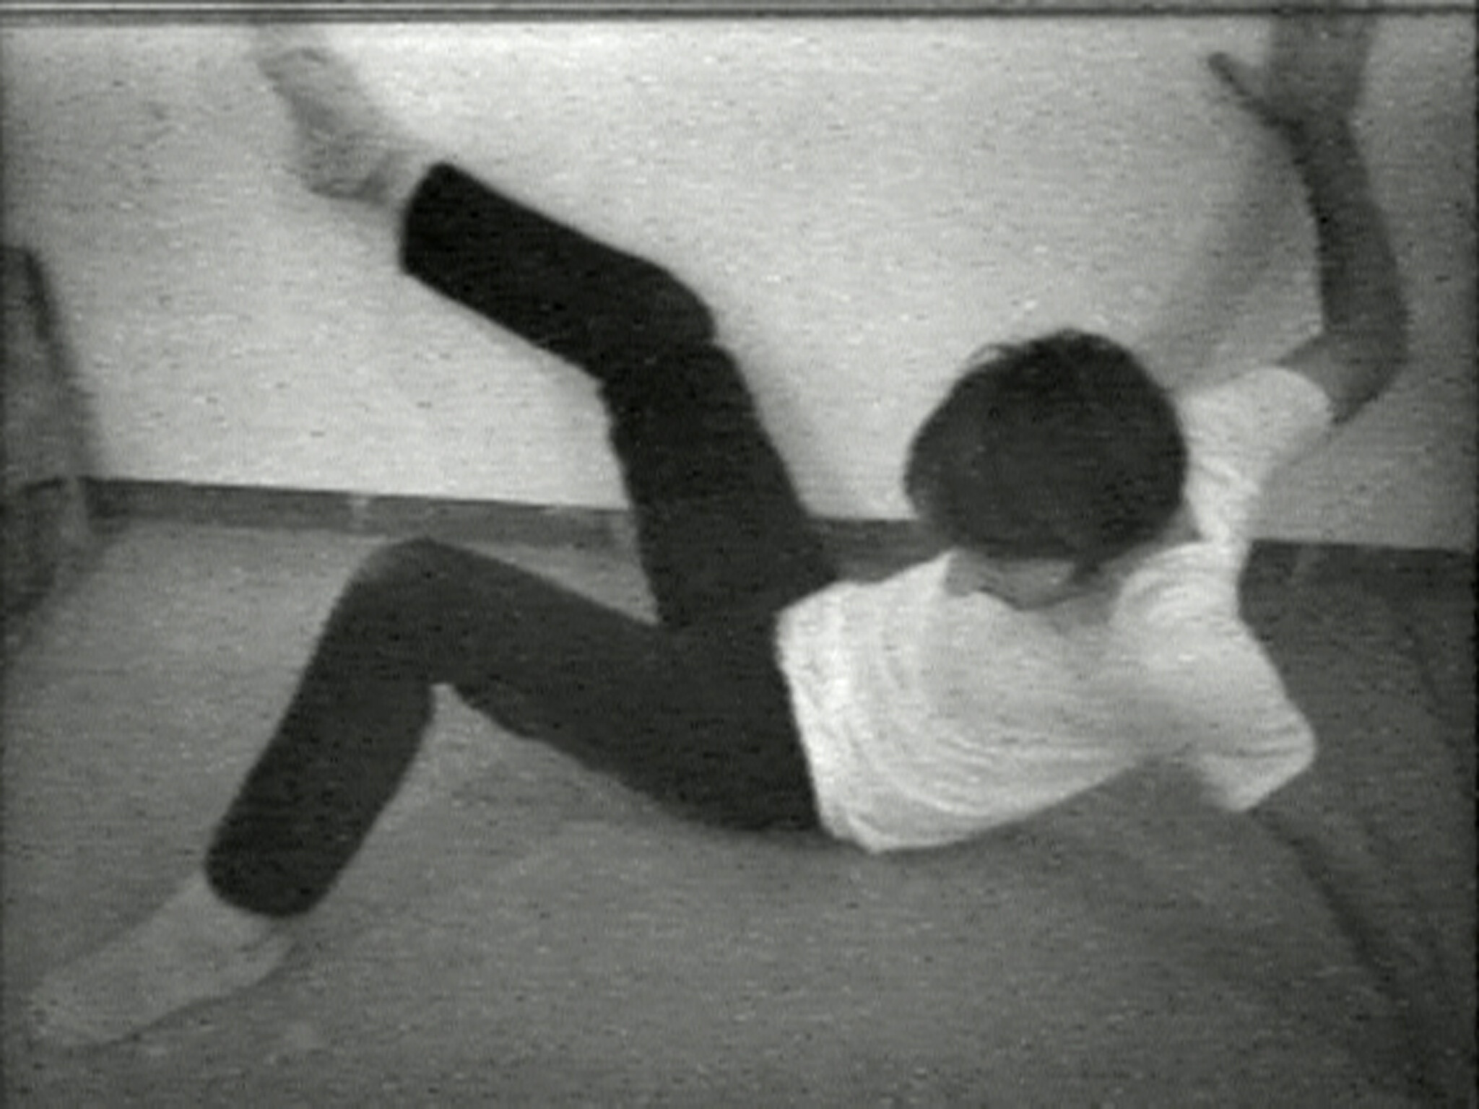


Gladwell → time-based exploration of movement, space and experience
Nauman → performance-based exploration of time, repetition and the body
Reverse Chronology: Shaun Gladwell → Bruce Nauman
Shaun Gladwell’s video works explore movement, repetition and duration, using the body to investigate experience, space and identity over time.
This connects to the work of Bruce Nauman, who used performance and video to record the body moving through space over a set duration. In works such as Wall-Floor Positions, Nauman explores how time, repetition and physical action can become the artwork itself.
While Nauman documents simple actions over time, Gladwell extends this into cinematic video works where movement, environment and duration combine to create meaning.
This shows how artists move from recording time to shaping time as a key part of the artwork.

Slide 7

Aspect | Bruce Nauman (Historical) | Shaun Gladwell (Contemporary)
Time Period | Late 20th-century (1960s–70s) | Contemporary Australian
Art Movement / Tradition | Conceptual art / Performance art | Contemporary video / performance
Primary Focus | Time, repetition and the body | Movement, duration and experience
Subject Matter | The artist’s body performing simple actions | The body moving through environments (urban, landscape)
Use of Time | Time recorded through repeated actions over a set duration | Time shaped through slow motion, pacing and editing
Use of Movement | Minimal, repetitive, often constrained movement | Fluid, extended, often stylised movement
Composition | Static camera, fixed viewpoint | Cinematic framing and considered composition
Lens Application | Body used to explore time and physical limits | Body used to explore psychological and spatial experience
Meaning Shift | Focus on process, duration and action as the artwork | Focus on experience, perception and emotional resonance over time
Context | Reaction against traditional art forms, focus on idea over object | Contemporary interest in identity, environment and media
Key Similarity | Uses time and the body as central to meaning | Uses time and the body as central to meaning
Key Difference | Records time through simple repeated action | Shapes time through cinematic and environmental experience
This comparison shows how artists move from recording time as an action to shaping time as an experience.

